Slide 1


Individual Homework
Cotor Catinca Florina, group 912

Slide 2
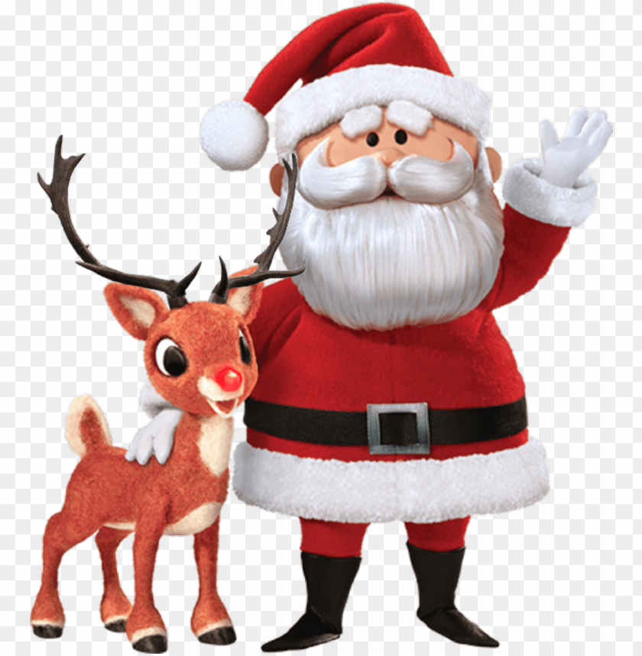
Modeling reasoning
Hypotheses:
H1. Every child loves Santa.
H2. Everyone who loves Santa loves any reindeer.
H3. Rudolph is a reindeer, and Rudolph has a red nose.
H4. Anything which has a red nose is weird or is a clown.
H5. No reindeer is a clown.
H6. Scrooge does not love anything which is weird.
Conclusion:
C. Scrooge is not a child.
Check whether the following deduction holds:
H1,H2,H3,H4, H5, H6 |— C

Slide 3
Modeling reasoning(contd.)
Hypotheses:
H1. Every child loves Santa.
H2. Everyone who loves Santa loves any reindeer.
H3. Rudolph is a reindeer, and Rudolph has a red nose.
H4. Anything which has a red nose is weird or is a clown.
H5. No reindeer is a clown.
H6. Scrooge does not love anything which is weird.
Conclusion:
C. Scrooge is not a child.
Check whether the following deduction holds:
H1,H2,H3,H4, H5, H6 |— C
First order predicate formulas:
H1. (∀x)(ch(x) -> love(x, Santa))
H2. (∀x)(love(x, Santa) ->(∀y) (ir(y) -> loves(x, y)))
H3. ir(Rudolph) ∧ rn(Rudolph)
H4. (∀x)(rn(x) -> iw(x) ∨ ic(x))
H5. ¬(∃x)(ir(x) ∧ ic(x)) ≡ (∀x)(ir(x) -> ¬ic(x))
H6. (∀x)(iw(x) -> ¬love(Scrooge, x))
C. ¬ch(Scrooge)
ch: D -> {T,F}, ch(x) = T if x is a child
love: D X D -> {T,F}, love(x, y) = T if x loves y
ir: D -> {T,F}, lr(x) = T if x is reindeer
iw: D->{T,F}, iw(x)=T if x is weird
ic: D -> {T,F}, ic(x)=T if x is clown
rn: D -> {T,F}, rn(x)=T if x has red nose
D is the domain(the universe of creatures)
Rudolph, Santa and Scrooge are constants
Unary predicate symbols: ch, ir, rn, iw, ic
Binary predicate symbols: love

Slide 4
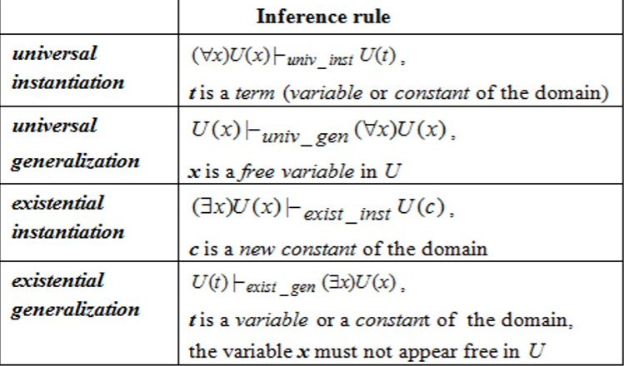
Building deductions
H1. (∀x)(ch(x) -> love(x, Santa)​) : f₁
H2. (∀x)(love(x, Santa) ->(∀y) (ir(y) -> love(x, y)))
≡ (∀x)(∀y)(love(x, Santa) -> (ir(y) -> love(x, y))) :f₂
H3. ir(Rudolph) ∧ rn(Rudolph) : f₃
H4. (∀x)(rn(x) -> iw(x) ∨ ic(x)) : f₄
H5.¬(∃x)(ir(x) ∧ ic(x) ≡ (∀x)(ir(x) -> ¬ic(x)) :f₅
H6. (∀x)(iw(x) -> ¬love(Scrooge, x)) : f₆
C. ¬ch(Scrooge)
f₃ |- _{simplification} ir(Rudolph) :f₇
f₃ |- _{simplification} rn(Rudolph):f₈
f₄ |-_{universal instantiation} rn(Rudolph)-> iw(Rudolph) ∨ ic(Rudolph) :f₉
f₅ |-_{universal instantiation} ir(Rudolph) -> ¬ic(Rudolph) :f₁₀
f₈ , f₉ |- _{mp} iw(Rudolph) ∨ ic(Rudolph) ≡ ¬ iw(Rudolph)-> ic(Rudolph) :f₁₁
f₇ , f₁₀ |- _{mp} ¬ic(Rudolph) :f₁₂
f₁₁ , f₁₂ |- _{mt} iw(Rudolph) :f₁₃
f₆ |- _{universal instantiation} iw(Rudolph) ->¬love(Scrooge, Rudolph) :f₁₄
f₁₃ , f₁₄ |-_{mp} ¬love(Scrooge, Rudolph) :f₁₅
f₂ |- _{universal instantiation} (∀y)(love(Scrooge, Santa)->ir(y)->love(Scrooge, y)):f₁₆
f₁₆ |- _{universal instantiation} love(Scrooge, Santa) ->ir(Rudolph)->love(Scrooge, Rudolph): f₁₇
f₁₅, f₁₇ |-_{mt} ¬(love(Scrooge, Santa)->ir(Rudolph)) ≡ ¬(¬(love(Scrooge, Santa)
∧¬ir(Rudolph))) ≡ love(Scrooge, Santa) -> ¬ir(Rudoplh) : f₁₈
f₇, f₁₈ |-_{mt} ¬love(Srooge, Santa) :f₁₉
f₁ |- _{universal instantiation} ch(Scrooge)->love(Scrooge, Santa):f₂₀
f₁₉, f₂₀ |- _{mt} ¬ch(Scrooge) :f₂₁ =C
(H1, H2, H3, H4, H5, H6, f_{i} (i∈{1, 2,…,21})) is the proof of C from hypotheses.

